Slide 1


Tuesday
UCSB Department of Communication Jumpstart program 2025
Hannah Overbye-Thompson
Department of Communication
Notes:
Ice breaker

Slide 2



Ice breaker
Notes:
Introduction and Ice breakers
What’s a surprising statistic about yourself (e.g., the number of times you’ve moved, books you've read, etc.)?
If you could visualize one type of personal data for the past year, what would it be (e.g., emotions, productivity, social interactions)?

Slide 3
Independent and dependent variables
Independent variable: The variable the researcher manipulated (generally) – variation does not depend on another variable
IV
Manipulated variable
Explanatory variable
Dependent variable: The result or outcome variable
DV
Outcome
Response variable
Notes:
Do math worksheet where we run through calculating the standard deviation as a warm up for what grad math will be like. Keep it fun and light hearted, this may be easy but that is the point.

Slide 4
Levels of Measurement
Nominal: Categorical data, not ordered
Colors of starbursts
Ordinal: Observations are categorical and ordered
Poor, middle class, wealthy
Interval: Numeric, represents equal intervals with an arbitrary zero point
Temperature
Ratio: Numeric, represents equal intervals with an absolute zero point
Height, weight, unemployment rate
Notes:
Do math worksheet where we run through calculating the standard deviation as a warm up for what grad math will be like. Keep it fun and light hearted, this may be easy but that is the point.

Slide 5
Measures of central tendency
1 | 2 | 1 | 1 | 1 | 0 | 3 | 5 | 2 | 2 | 3
Three main measures of centrality
MEAN (or Average): (1+2+1+1+1+0+3+5+2+2+3)/11 = 1.91
MEDIAN: mid point value. Reorder in increasing order: [0, 1, 1, 1, 1, 2, 2, 2, 3, 3, 5] Middle value is 2.
MODE: most repeated value 1 is repeated the most times -- the mode is 1

Slide 6
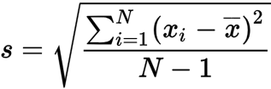
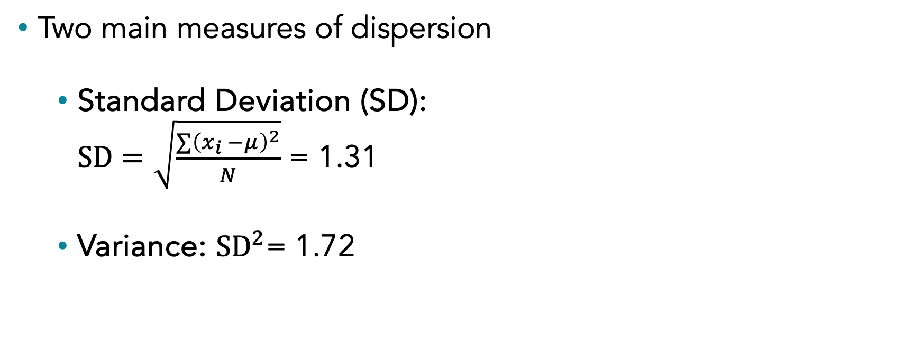
Standard deviation and variance
1 | 2 | 1 | 1 | 1 | 0 | 3 | 5 | 2 | 2 | 3
Two main measures of dispersion
Standard Deviation (SD): $SD=\sqrt{\frac{∑{\left(x_{i} −μ\right)}^{2}}{N}}$ = 1.31
Variance: ${SD}^{2}\text{= 1.}\text{72}$
Notes:
measures of dispersion, which help us understand how spread out data points are in a dataset. The two main measures we will focus on are Standard Deviation (SD) and Variance.
Standard Deviation is a way to tell us how much the individual data points in a set differ from the average (mean) value of that set. In simpler terms, it shows how "spread out" the numbers are.
𝑥_i: These are the individual data points in your dataset.𝜇
(mu): This is the mean (average) of the dataset.
N: This is the total number of data points.
∑(𝑥_𝑖 − 𝜇)^2: We calculate the difference between each data point and the mean, then square that difference to get rid of any negative values.
Variance is another measure of dispersion, and it's actually the square of the standard deviation. It tells us the average of the squared differences from the mean.
Variance is useful for many statistical calculations, but because it's based on squared differences, its units are not the same as the original data. That’s why we usually prefer to use standard deviation, which is in the same units as the original data, to describe how spread out the values are.
Variance is often easier to work with in mathematical formulas because it doesn't require the square root that standard deviation does. When you're dealing with multiple datasets or more complex statistical methods, variance fits into the calculations more smoothly. For example, in the field of machine learning and statistical modeling, formulas often use variance instead of standard deviation for simplicity.
2. Intermediate Step in Calculating Standard Deviation
Variance is an intermediate step toward calculating standard deviation. To compute standard deviation, we first calculate the variance. It’s like the building block for finding SD, which is why understanding variance is so important.
3. Handling Multiple Variables: Covariance and Correlation
When you're working with multiple variables, covariance (which measures how two variables vary together) and correlation (a standardized measure of the same thing) are both based on variance. Variance plays a crucial role in defining relationships between different variables.

Slide 7
Data Distribution
1 | 2 | 1 | 1 | 1 | 0 | 3 | 5 | 2 | 2 | 3
How is the data SPREAD across different values?
Centrality and dispersion measures are key elements to define a distribution
Often graphically shown to “visualize” the spread
X axis: values
Y axis: probability of occurrence

Slide 8
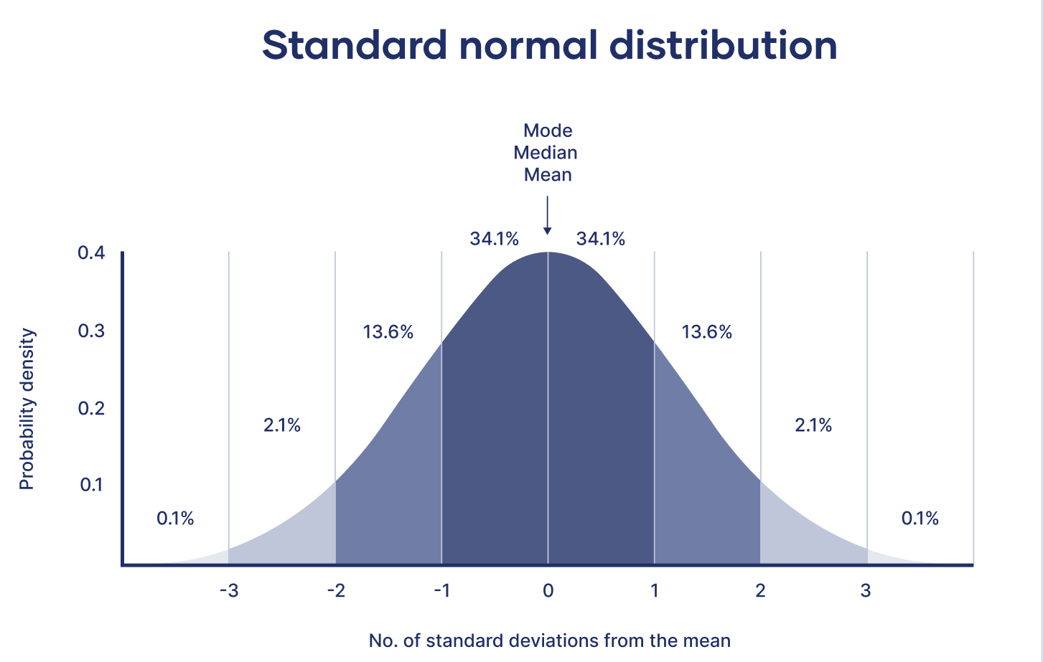
Normal and skewed distributions
Notes:
Do math worksheet where we run through calculating the standard deviation as a warm up for what grad math will be like. Keep it fun and light hearted, this may be easy but that is the point.

Slide 9
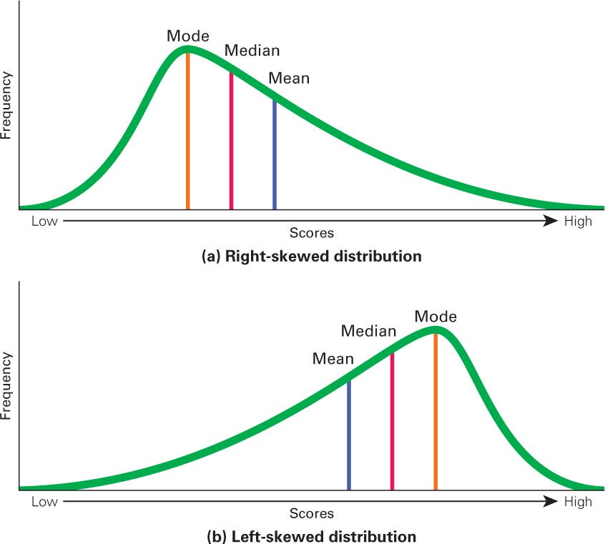
Normal and skewed distributions
Notes:
Do math worksheet where we run through calculating the standard deviation as a warm up for what grad math will be like. Keep it fun and light hearted, this may be easy but that is the point.

Slide 10
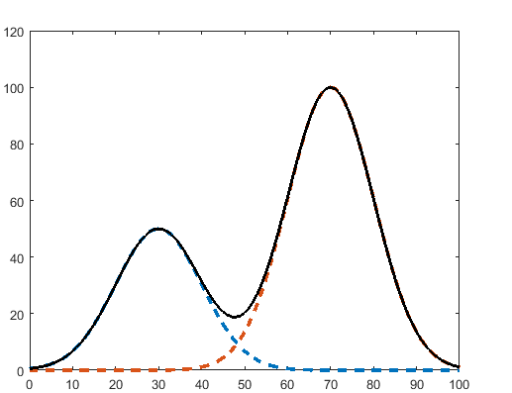
Bi-Modal Distribution
The name says it all: Bi-Modal; Two Modes!

Slide 11
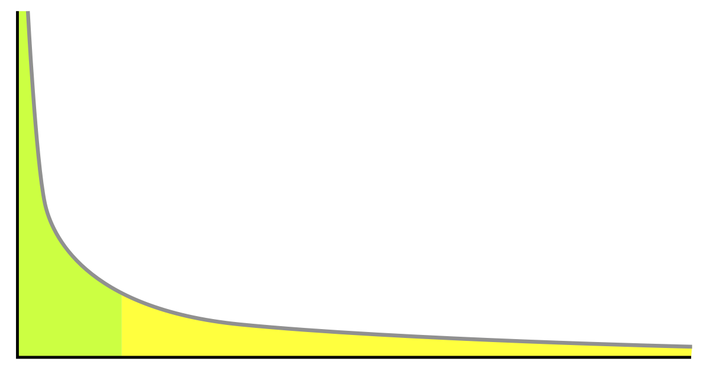
Power Law Distribution
When few values are very common, but most values are very rare!
Examples:
Word frequencies in languages
Active users on social media platforms
Distribution of wealth generation
Relationships in our social networks

Slide 12
IMPORTANT CONCEPT! Usually in the social sciences we do what is known as “hypothesis testing”; we want to know probability that something would happen by chance.

Slide 13
IMPORTANT CONCEPT! But how small must the probability of an event happening by chance be for us to consider it "significant"?

Slide 14
IMPORTANT CONCEPT! Usually, social scientists say that the probability of something happening by chance has to be less than 5% for it to be considered significant

Slide 15
IMPORTANT CONCEPT! P < .05!

Slide 16
Overview of Common Statistical Tests
Notes:
Do math worksheet where we run through calculating the standard deviation as a warm up for what grad math will be like. Keep it fun and light hearted, this may be easy but that is the point.
Worksheet lives in the google drive.
Remind students that these are just terms they are building familiarity with, and that it is okay to not have everything memorized now. This is their first introduction (or refresher) that will be built on later as their time in the grad program continues

Slide 17
Is my data continuous or categorical?
Continuous
Categorical
How many variables am I comparing?
How many variables am I comparing?
1
2+
1
2
3+
One sample t-test
Type of Question
Chi Square Goodness of Fit Test
Chi Square Test of Association
Logistic Regression
Relationships
Differences Between Means
Do you have an independent variable?
How Many Groups?
Do you want to control for covariates?
Yes
No
2+
2
Regression
Correlation
Yes
No
How many Dependent variables?
Are the groups related?
ANCOVA
Yes
1
2+
No
ANOVA
MANOVA
Paired samples T-test
Independent Samples T-test

Slide 18
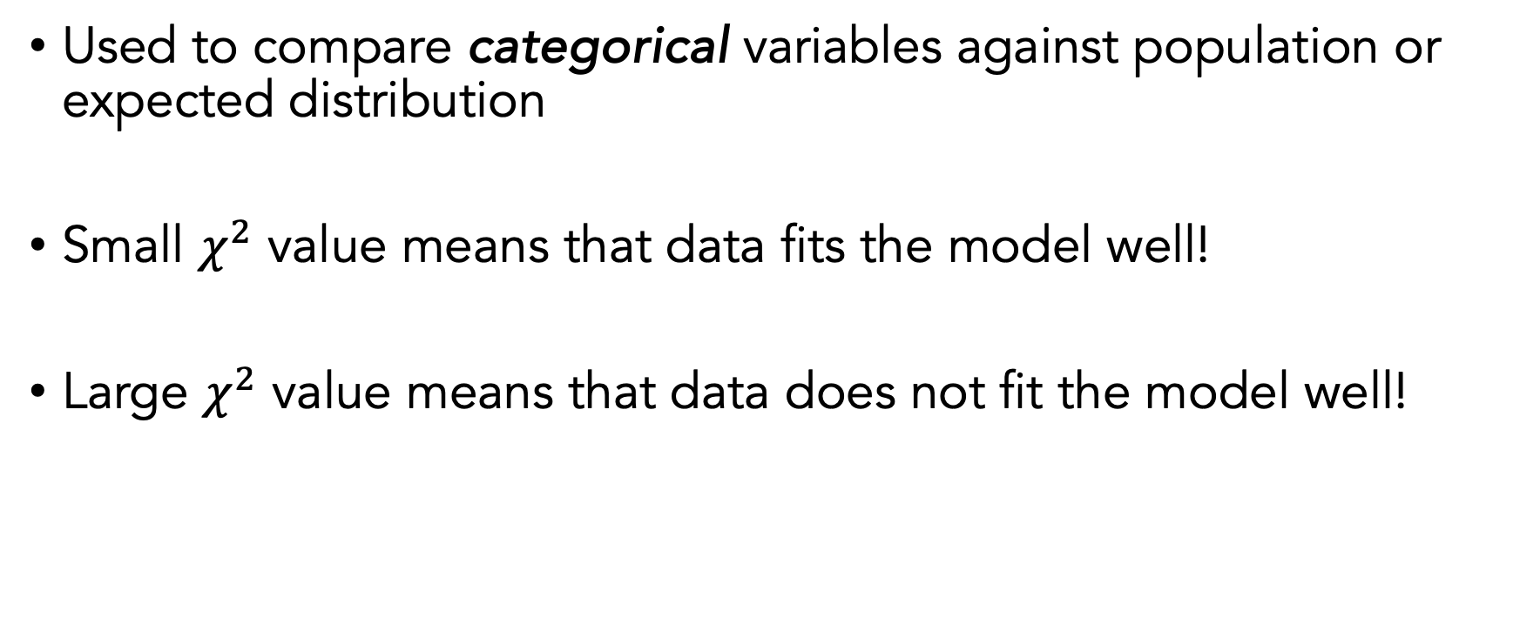

Comparing Data – Chi-Squared ($χ^{2}$) Test
Used to compare categorical variables against population or expected distribution
Small $χ^{2}$ value means that data fits the model well!
Large $χ^{2}$ value means that data does not fit the model well!

Slide 19
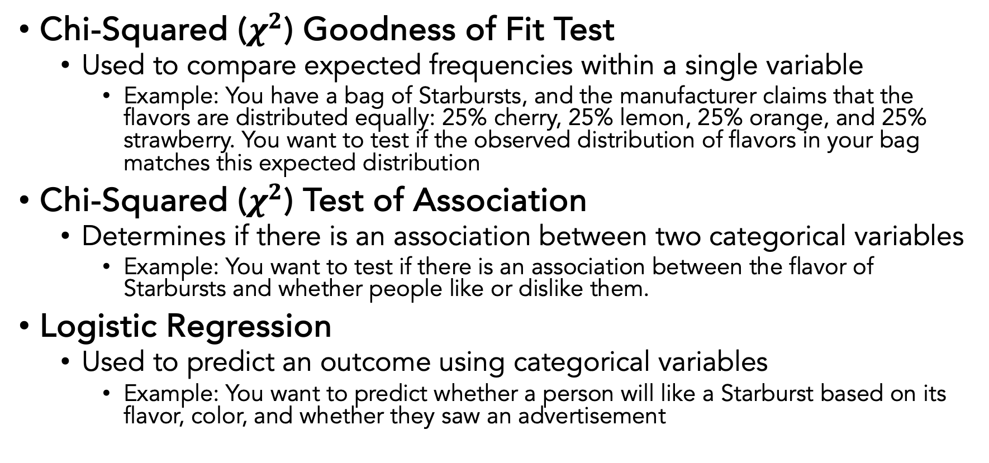
Comparing Data – Chi-Squared ($χ^{2}$) Test
Chi-Squared ($χ^{2}$) Goodness of Fit Test
Used to compare expected frequencies within a single variable
Example: You have a bag of Starbursts, and the manufacturer claims that the flavors are distributed equally: 25% cherry, 25% lemon, 25% orange, and 25% strawberry. You want to test if the observed distribution of flavors in your bag matches this expected distribution
Chi-Squared ($χ^{2}$) Test of Association
Determines if there is an association between two categorical variables
Example: You want to test if there is an association between the flavor of Starbursts and whether people like or dislike them.
Logistic Regression
Used to predict an outcome using categorical variables
Example: You want to predict whether a person will like a Starburst based on its flavor, color, and whether they saw an advertisement

Slide 20
Is my data continuous or categorical?
Continuous
Categorical
How many variables am I comparing?
How many variables am I comparing?
1
2+
1
2
3+
One sample t-test
Type of Question
Chi Square Goodness of Fit Test
Chi Square Test of Association
Logistic Regression
Relationships
Differences Between Means
Do you have an independent variable?
How Many Groups?
Do you want to control for covariates?
Yes
No
2+
2
Regression
Correlation
Yes
No
How many Dependent variables?
Are the groups related?
ANCOVA
Yes
1
2+
No
ANOVA
MANOVA
Paired samples T-test
Independent Samples T-test

Slide 21
One sample T-test
Used to determine whether the mean of a single sample is significantly different from a known or hypothesized population mean
Example: Suppose you have a bag of Starbursts and you want to test if the average weight of the Starbursts in this bag is different from the advertised average weight of 5 grams.

Slide 22
Is my data continuous or categorical?
Continuous
Categorical
How many variables am I comparing?
How many variables am I comparing?
1
2+
1
2
3+
One sample t-test
Type of Question
Chi Square Goodness of Fit Test
Chi Square Test of Association
Logistic Regression
Relationships
Differences Between Means
Do you have an independent variable?
How Many Groups?
Do you want to control for covariates?
Yes
No
2+
2
Regression
Correlation
Yes
No
How many Dependent variables?
Are the groups related?
ANCOVA
Yes
1
2+
No
ANOVA
MANOVA
Paired samples T-test
Independent Samples T-test

Slide 23
Linear Regression
Another way to analyze the influence of multiple IVs on a DV
ASSUMPTION: normal distribution of data
Looks for a LINEAR relationship between the IVs (X) and the DV (Y)
General Linear Model
y = a₀ + a₁x₁ + a₂x₂ + … + a_{n}x_{n}

Slide 24
Linear Regression
Note:
a₀ = 5.65
a₁ = 2.22
Calculated via
Linear Regression.
y = a₀ + a₁x₁ + a₂x₂ + … + a_{n}x_{n} (general form)
y = a₀ + a₁x₁ (with 1 IV)
Example:
Imagine you want to predict the satisfaction score of people eating Starbursts based on the number of Starbursts they consume.
Your data suggests different values of the DV for different values of your IV, so you plot them DV vs IV
You approximate the relationship as a linear one
The approximation is best described as: y = 5.65 + 2.22 x
Since this is not a “perfect fit”, you expect some “error” in the model (aka residuals)
y (DV)
y = 5.65 + 2.22 x
+ e
Satisfaction
x (IV)
Number of starbursts consumed

Slide 25
Correlation
Correlation analysis is used to measure the strength and direction of the relationship between two variables. You do not have a dependent or independent variable
Example: You want to look at if the sweetness of a starburst is related to the intensity of it’s color

Slide 26
Is my data continuous or categorical?
Continuous
Categorical
How many variables am I comparing?
How many variables am I comparing?
1
2+
1
2
3+
One sample t-test
Type of Question
Chi Square Goodness of Fit Test
Chi Square Test of Association
Logistic Regression
Relationships
Differences Between Means
Do you have an independent variable?
How Many Groups?
Do you want to control for covariates?
Yes
No
2+
2
Regression
Correlation
Yes
No
How many Dependent variables?
Are the groups related?
ANCOVA
Yes
1
2+
No
ANOVA
MANOVA
Paired samples T-test
Independent Samples T-test

Slide 27
T-Test part 2!
Paired Samples T-Test
Used to compare the means of two related groups . Often used in “before-and-after” scenarios (within sample)
Example: you want to test if there is a significant difference in the preference ratings for Starbursts before and after a marketing campaign.
Independent Samples T-Test
Used to compare the means of two independent groups (between samples)
Example: You want to test if there is a significant difference in preference ratings for two different flavors of Starbursts: Cherry and Lemon

Slide 28
Is my data continuous or categorical?
Continuous
Categorical
How many variables am I comparing?
How many variables am I comparing?
1
2+
1
2
3+
One sample t-test
Type of Question
Chi Square Goodness of Fit Test
Chi Square Test of Association
Logistic Regression
Relationships
Differences Between Means
Do you have an independent variable?
How Many Groups?
Do you want to control for covariates?
Yes
No
2+
2
Regression
Correlation
Yes
No
How many Dependent variables?
Are the groups related?
ANCOVA
Yes
1
2+
No
ANOVA
MANOVA
Paired samples T-test
Independent Samples T-test

Slide 29
ANOVA, ANCOVA & MANOVA
ANOVA (analysis of variance)
Used to compare the means of three or more groups to see if there is a significant difference between them.
Example: You want to test if there is a significant difference in preference ratings for three different flavors of Starbursts: Cherry, Lemon, and Strawberry.
ANCOVA
Used to compare the means of three or more groups while controlling for the effect of one or more covariates.
Example: You want to test if there is a significant difference in preference ratings for three different flavors of Starbursts: Cherry, Lemon, and Strawberry, while controlling for age
MANOVA
Used to compare the means of multiple dependent variables across groups
Example: You want to test if there is a significant difference in preference ratings AND purchase likelihood for three different flavors of Starbursts: Cherry, Lemon, and Strawberry.

Slide 30
How do I know what type of statistical test to use?

Slide 31
Is my data continuous or categorical?
Continuous
Categorical
How many variables am I comparing?
How many variables am I comparing?
1
2+
1
2
3+
One sample t-test
Type of Question
Chi Square Goodness of Fit Test
Chi Square Test of Association
Logistic Regression
Relationships
Differences Between Means
Do you have an independent variable?
How Many Groups?
Do you want to control for covariates?
Yes
No
2+
2
Regression
Correlation
Yes
No
How many Dependent variables?
Are the groups related?
ANCOVA
Yes
1
2+
No
ANOVA
MANOVA
Paired samples T-test
Independent Samples T-test

